Slide 1
Case Study Project - Property Rentals
Rental price predictor application for San Francisco

Slide 2
Overview
San Francisco is second-most-active rental market, after NYC
Rental applications in San Francisco in the first half of 2021 were up 79 percent compared with the first half of 2020.
Only New York had a more active rental market.

Slide 3
Business problem
A housing rental company are interested in developing an application to help people estimate the money they could earn renting out their living space.
They want to avoid estimating prices that are more than 25 dollars from the actual price.

Slide 4

Source & Methodology
Data has been provided by the organization, with additional features added on top of it.
After cleaning and feature engineering, the dataset has 2496 rows and 10 columns.
Different machine learning techniques were applied on the data set to predict the rental price.
The final model is within 23 dollars from the actual price. With the ability of explaining 50% of the price change.

Slide 5
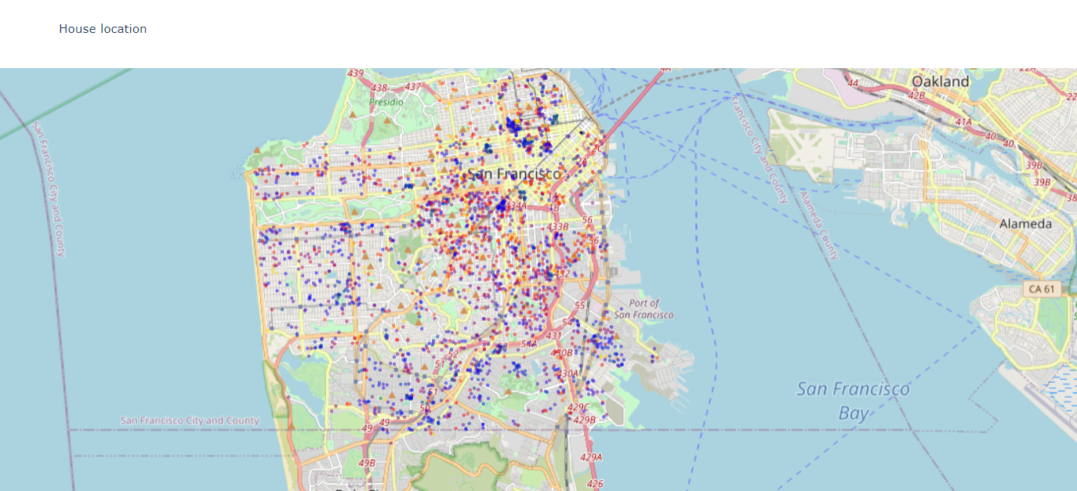
Blue dots are the expensive rentals

Slide 6
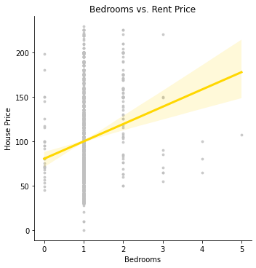
Bedroom vs Rental income
One bedroom is the most common type of rental.
More bedrooms tend to warrant more rental income.
Anything more than 3 is rare.

Slide 7
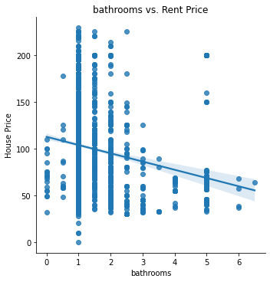
Bathroom vs Rental income
More bathroom does not necessarily mean more rental income.
This is because more bathroom means a shared space where people must share, thus high number of bathrooms

Slide 8
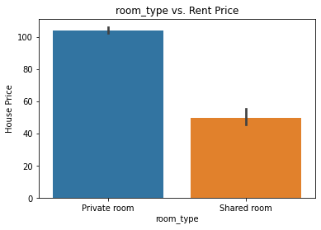
Room type on rental income
Listings of private room is more expensive than the shared one

Slide 9
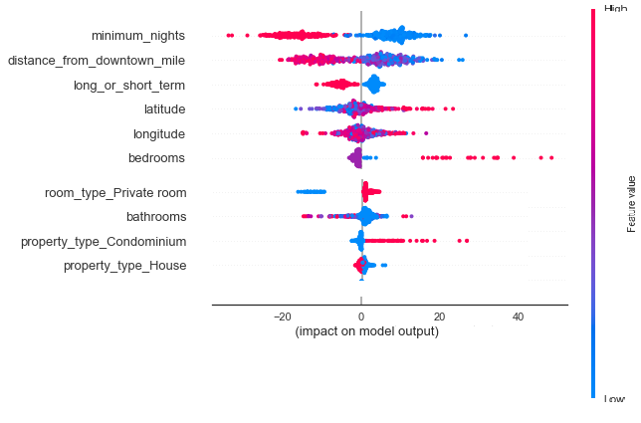
What makes the price?
Rental income is higher when rented for relatively short time.
Closer to the SF downtown means more rental income
Short term rentals are more cash generating
Rents are higher for listing with high count of bedroom
Surprisingly, shared room costs more, maybe because of the quality of the rental
Listings with lower count of bathrooms are costly to rent
Condo is the most expensive type of rentals

Slide 10
Recommendation
Rent out for short time frame
You can charge higher if your property is closer to the SF downtown
condo owners can expect higher rental income
location of your property does have an impact
Location is the prime determinant of rental price in the short term.

Slide 11
Thank you for your time!

